Slide 1
Support Vector Machines (Non-Linear)
Presented By:
Divyash Kumbhani
Jay Kanani
Sagar Bapodara
Instructor: Dr. Yaseer Alginahi
Date: October 20th, 2023
1

Slide 2
Table of Contents
Introduction
Types of SVM
Important Terminologies
Working of Non-Linear SVMs
Mathematics
Mathematics Behind Kernels
Numerical Example
Evaluation Metrics
Implementation
Applications
Example
Advantage and Limitations
Overcoming Limitations
2

Slide 3
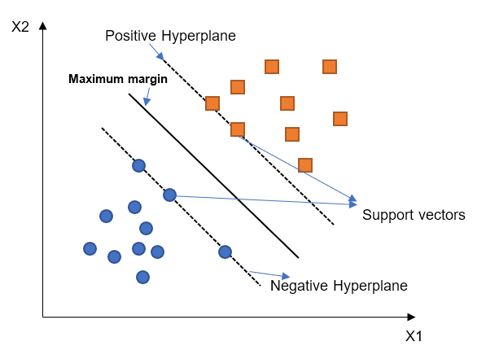
Introduction
Decision boundary and hyperplane for SVM.
Support Vector Machine (SVM) for Classification & Regression
Hyperplane to separate the classes.
Support vectors and margin for hyperplane.
Source: https://tinyurl.com/3r8cbjdk
3

Slide 4
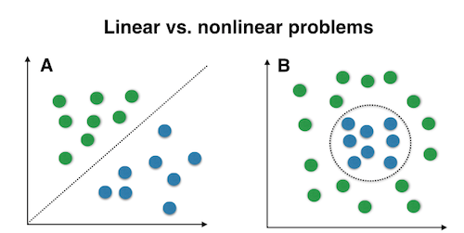
Types of SVM
Linear SVM
Non-Linear SVM
Data is linearly separable
Difficult for more than two Classes
Data is not linearly separable
Best for two or more than two Classes
Source: https://tinyurl.com/yyekewju
4

Slide 5
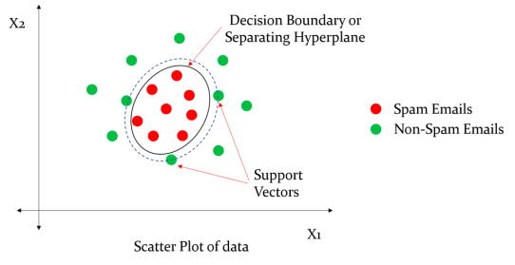
Non-Linear SVMs
Cannot be separated by a linear line
Transforms into higher dimensions & making it linearly separable
Non-linear decision boundary in the case of the Email Spam classification example.
Source: https://tinyurl.com/y8wy6p27
5

Slide 6
Important Terminologies
Hyperplane: Decision boundary - to separate the data points of different classes.
Support Vectors: Data points closest to the decision boundary
Margin: Distance between the decision boundary and the support vectors
Kernel: Mathematical function - transform into high-dimensional feature spaces. (Linear, polynomial, Radial basis function (RBF) and sigmoid)
Nonlinear Decision Boundaries: Complex decision boundaries - separate data points accurately
Regularization Parameter (C): Controls the trade-off between the misclassification of training examples and the margin width.
6

Slide 7
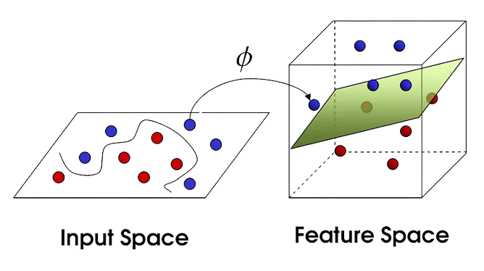
Non-Linear SVM: Working
Non-Linear to Linear space (2D to 3D transformation)
Finds the right Hyperplane (Which has the maximum margin)
Transformation of data points to higher dimensions
Source: https://tinyurl.com/bdcrdssz
7

Slide 8
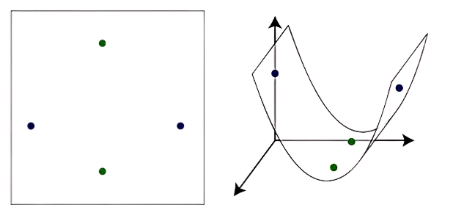
Kernel Trick
Method to project non-linear data onto higher dimensions.
Kernel Functions –
Linear
Polynomial
Gaussian radial basis function (RBF)
Sigmoid
Source: https://tinyurl.com/33khdvps
8

Slide 9
Linear Kernel
Linear Separability: separated by a single straight line.
Efficient Processing: computationally efficient, especially with 1-D features
Linear kernel for linearly separable data points
Source: https://tinyurl.com/3r8cbjdk
9

Slide 10
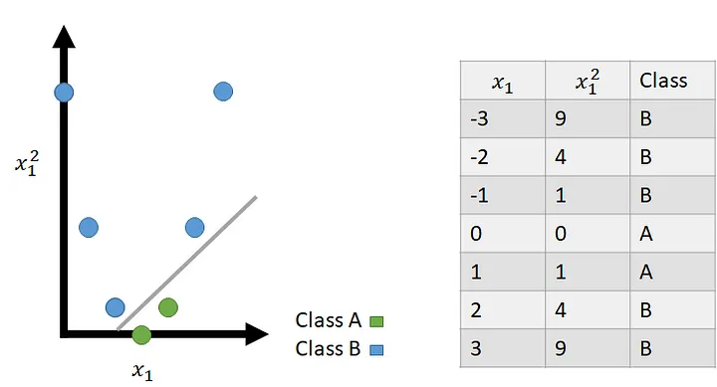
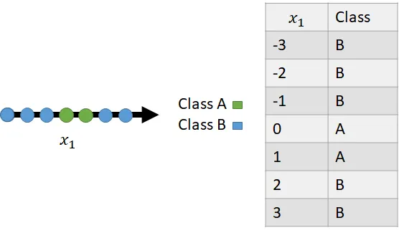
Polynomial Kernel
Polynomial Kernel – when data can be separated by some polynomial function.
Non-linear to linear transformation using polynomial kernel functions
Source: https://tinyurl.com/bdfr2hte
10

Slide 11
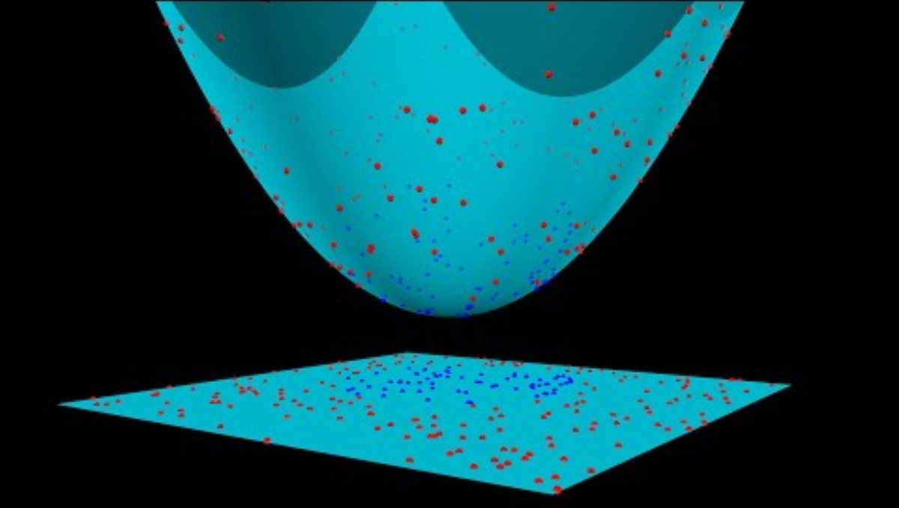
Polynomial Kernel Visualization
Source: https://youtu.be/OdlNM96sHio?si=CKDR-N_EntkYS9Q0
11

Slide 12
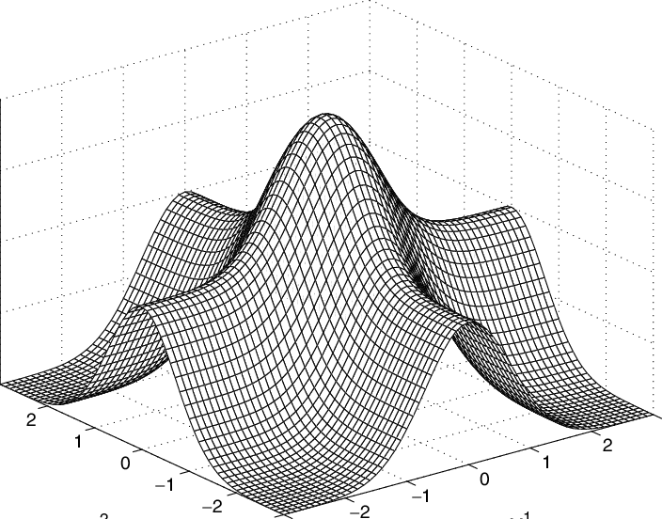
RBF Kernel
More complex & efficient
Can combine multiple polynomial kernels multiple time of different degrees.
Transformed version using RBF kernel
Source: https://doi.org/10.1007/10984697_3
12

Slide 13
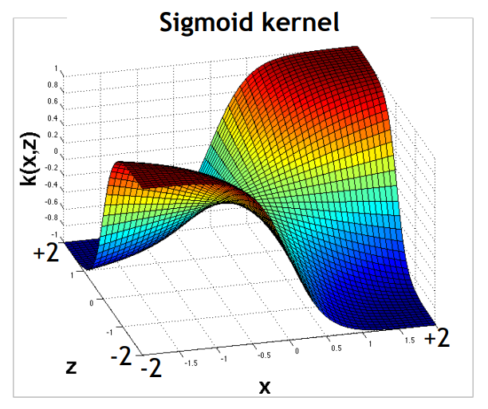
Sigmoid Kernel
Can capture complex non-linear data patterns.
Versatile and suitable for addressing data with unknown characteristics
Transformed version using Sigmoid kernel
Source: https://tinyurl.com/3x4cmamu
13

Slide 14
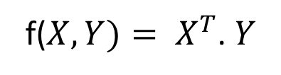
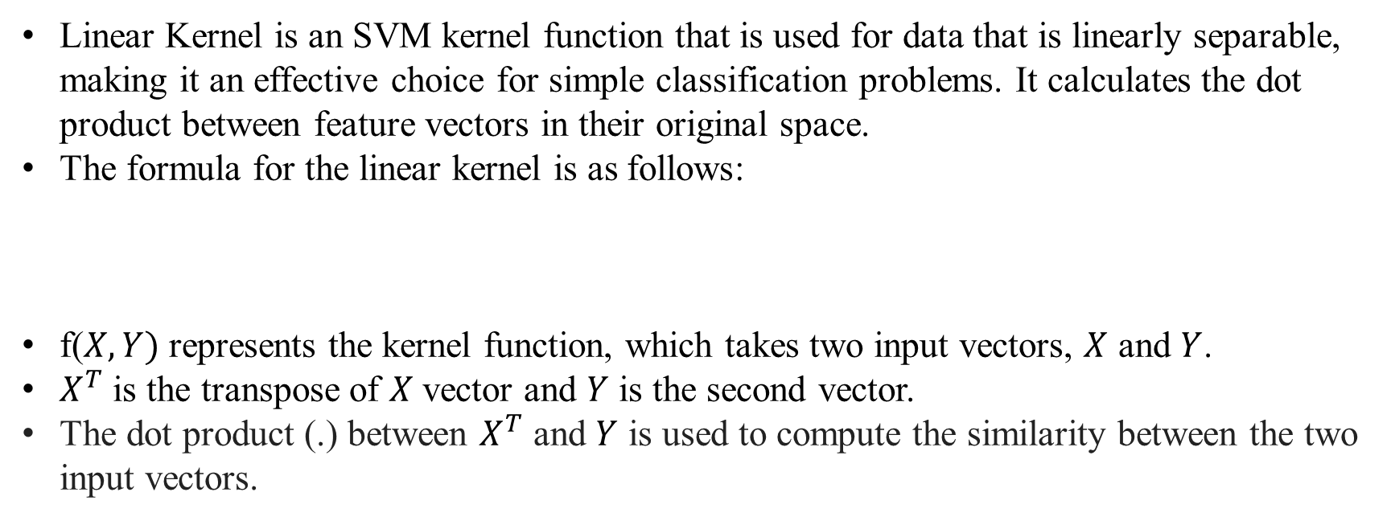
Mathematics: Linear Kernel Function
1. Linear Kernel function
Linear Kernel is an SVM kernel function that is used for data that is linearly separable, making it an effective choice for simple classification problems. It calculates the dot product between feature vectors in their original space.
The formula for the linear kernel is as follows:
f($X,Y)$represents the kernel function, which takes two input vectors, $X$ and $Y$.
$X^{T}$ is the transpose of $X$vector and $Y$ is the second vector.
The dot product (.) between $X^{T}$ and $Y$ is used to compute the similarity between the two input vectors.
f($X,Y)= X^{T}$. $Y$
14

Slide 15
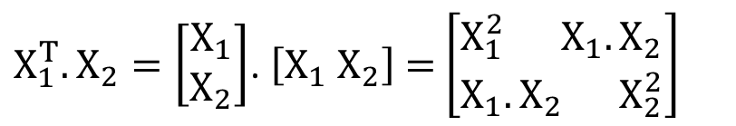
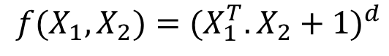
Mathematics: Polynomial Kernel Function
2. Polynomial Kernel function
The formula for the polynomial kernel is as follows:
Here, X₁ and X₂ are input feature vectors that indicate data points.
X₁ᵀ · X₂ is the dot product of two feature vectors, where X1T is the transpose of the first vector and X2 is the second vector.
d is the degree of the polynomial.
Assuming we have the two features X₁ and X₂ and Y as the output variable, we can define it as follows using the polynomial kernel:
$${f(X}_{1},X_{2})={(X_{1}^{T}.X_{2}+1)}^{d}$$
$X_{1}^{T}.X_{2}=\left[\begin{aligned}X_{1} \\ X_{2}\end{aligned}\right]$. $\left[X_{1}{ X}_{2}\right]$= $\left[\begin{aligned}X_{1}^{2}{ X}_{1}.X_{2} \\ X_{1}.X_{2}{ X}_{2}^{2}\end{aligned}\right]$
15

Slide 16
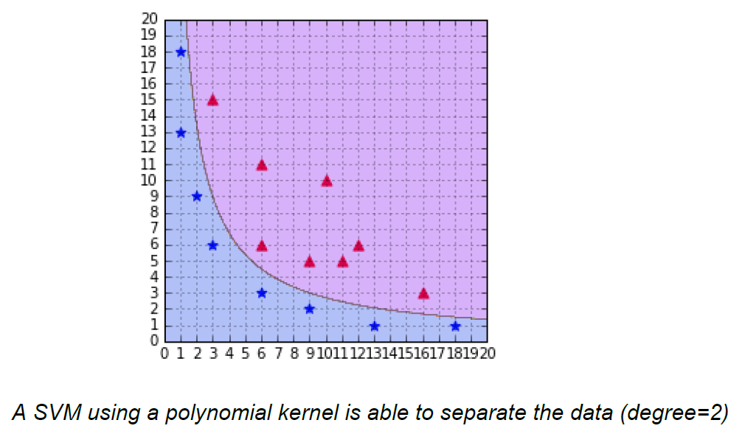
Mathematics: Polynomial Kernel Function
As a result, 2 dimensions were transformed into 5 dimensions.
SVM using a polynomial kernel is able to separate the data (degree=2)
Source: https://tinyurl.com/msxashrw
16

Slide 17
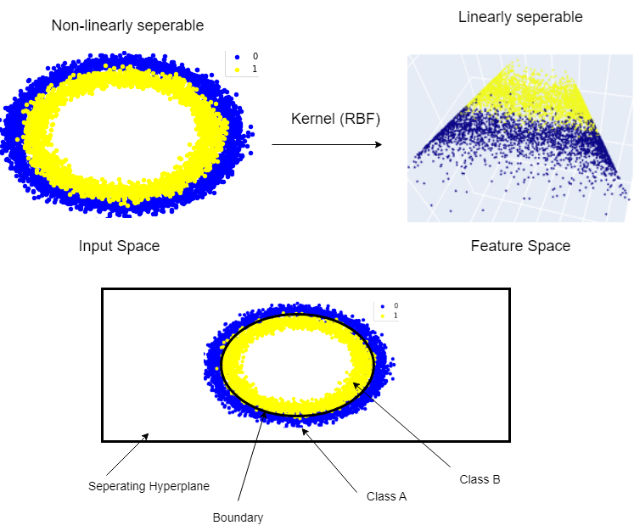
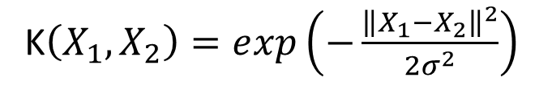
Mathematics: RBF Kernel
3. Radial Basis Function Kernel
The RBF kernel works by translating the data into a high-dimensional space and then doing classification using the core principle of Linear SVM.
The radial basis function is represented by the following formula:
K$\left(X_{1},X_{2}\right)=ⅇxp\left(−\frac{{\left\|X_{1}−X_{2}\right\|}^{2}}{2σ^{2}}\right)$
Source: https://tinyurl.com/y4fd4vc
17

Slide 18

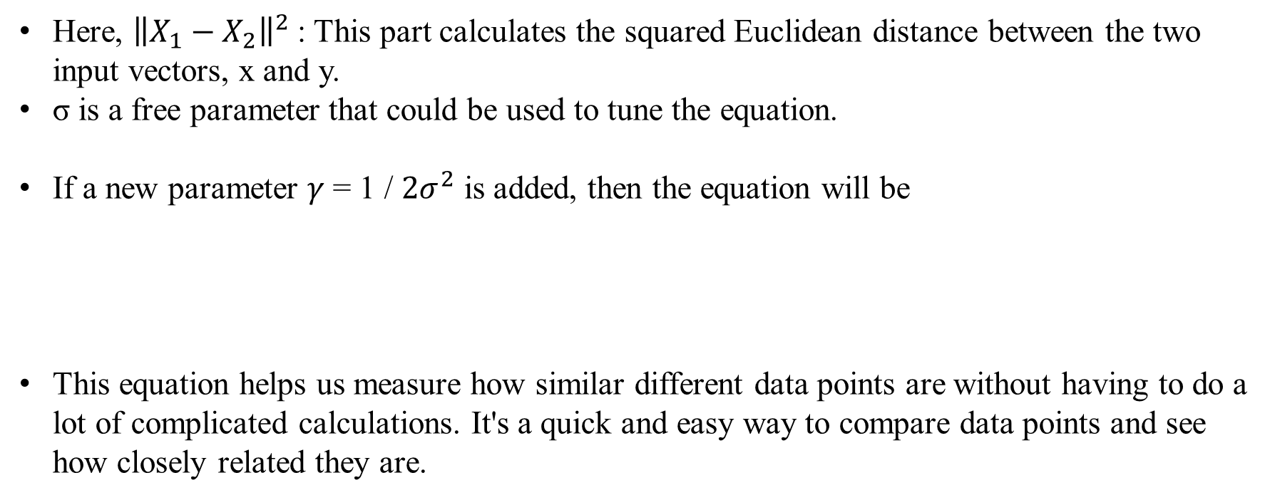
Mathematics: RBF Kernel
Here, ${\left\|X_{1}−X_{2}\right\|}^{2}$: This part calculates the squared Euclidean distance between the two input vectors, x and y.
σ is a free parameter that could be used to tune the equation.
If a new parameter $γ$ = 1 / $2σ^{2}$ is added, then the equation will be
This equation helps us measure how similar different data points are without having to do a lot of complicated calculations. It's a quick and easy way to compare data points and see how closely related they are.
K$\left(X_{1},X_{2}\right)$= $ⅇxp\left(−{γ\left\|X_{1}−X_{2}\right\|}^{2}\right)$
18

Slide 19
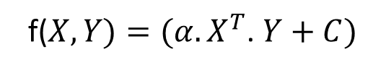
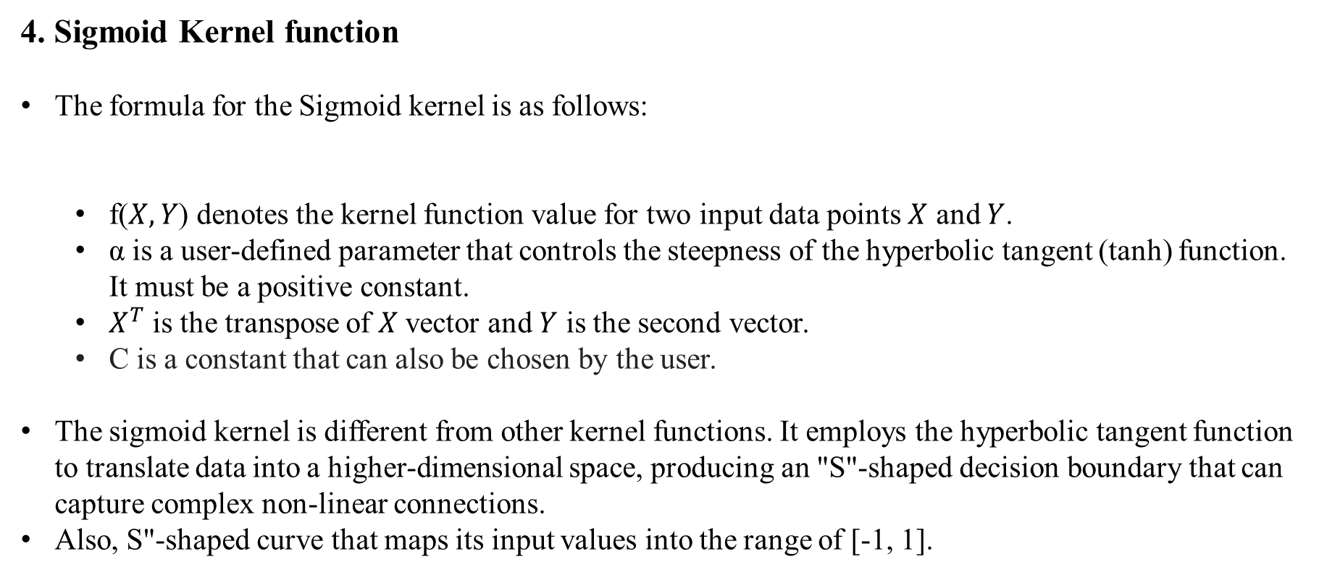
Mathematics: Sigmoid Kernel Function
4. Sigmoid Kernel function
The formula for the Sigmoid kernel is as follows:
f($X,Y$) denotes the kernel function value for two input data points $X$ and $Y$.
α is a user-defined parameter that controls the steepness of the hyperbolic tangent (tanh) function. It must be a positive constant.
$X^{T}$ is the transpose of $X$vector and $Y$ is the second vector.
C is a constant that can also be chosen by the user.
The sigmoid kernel is different from other kernel functions. It employs the hyperbolic tangent function to translate data into a higher-dimensional space, producing an "S"-shaped decision boundary that can capture complex non-linear connections.
Also, S"-shaped curve that maps its input values into the range of [-1, 1].
f($X,Y)=({α.X}^{T}$. $Y+C)$
19

Slide 20
Evaluation Metrics
Hinge Loss (Loss Function):
Measures classification performance in SVM.
Encourages a wide margin between different classes.
Hinge Loss = max(0, 1 - y*f(x))
y is the true label.
f(x) is the model's prediction.
Penalty Term (Regularization):
Control overfitting.
Adjusted by hyperparameter C.
Cost = Hinge Loss + C * Regularization Term
C = Controls balance between margin and classification errors
In nonlinear SVMs, a kernel function (e.g., RBF, polynomial) indicates data to a higher-dimensional space for linear separation.
The hinge loss and penalty term operate in this transformed area.
20

Slide 21
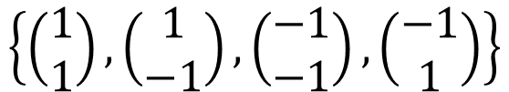
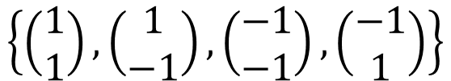
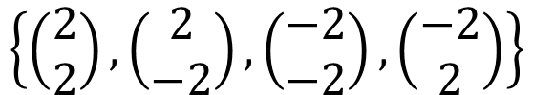
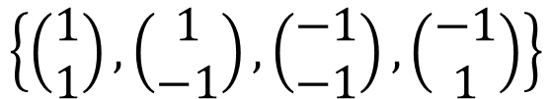
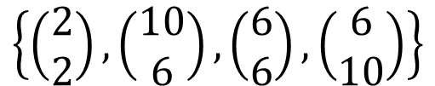
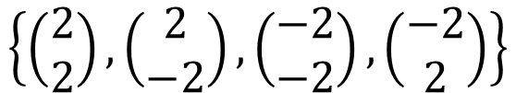
Numerical Example
Numerical example for Non-Linear SVM:
Let's suppose we are provided with the positively labelled data points below:
$$\left\{\left(\begin{matrix}2 \\ 2\end{matrix}\right),\left(\begin{matrix}2 \\ −2\end{matrix}\right),\left(\begin{matrix}−2 \\ −2\end{matrix}\right),\left(\begin{matrix}−2 \\ 2\end{matrix}\right)\right\}$$
$$\left\{\left(\begin{matrix}2 \\ 2\end{matrix}\right),\left(\begin{matrix}2 \\ −2\end{matrix}\right),\left(\begin{matrix}−2 \\ −2\end{matrix}\right),\left(\begin{matrix}−2 \\ 2\end{matrix}\right)\right\}$$
$$\left\{\left(\begin{matrix}2 \\ 2\end{matrix}\right),\left(\begin{matrix}10 \\ 6\end{matrix}\right),\left(\begin{matrix}6 \\ 6\end{matrix}\right),\left(\begin{matrix}6 \\ 10\end{matrix}\right)\right\}$$
And negatively labelled data points below:
$$\left\{\left(\begin{matrix}1 \\ 1\end{matrix}\right),\left(\begin{matrix}1 \\ −1\end{matrix}\right),\left(\begin{matrix}−1 \\ −1\end{matrix}\right),\left(\begin{matrix}−1 \\ 1\end{matrix}\right)\right\}$$
$$\left\{\left(\begin{matrix}1 \\ 1\end{matrix}\right),\left(\begin{matrix}1 \\ −1\end{matrix}\right),\left(\begin{matrix}−1 \\ −1\end{matrix}\right),\left(\begin{matrix}−1 \\ 1\end{matrix}\right)\right\}$$
$$\left\{\left(\begin{matrix}1 \\ 1\end{matrix}\right),\left(\begin{matrix}1 \\ −1\end{matrix}\right),\left(\begin{matrix}−1 \\ −1\end{matrix}\right),\left(\begin{matrix}−1 \\ 1\end{matrix}\right)\right\}$$
21

Slide 22
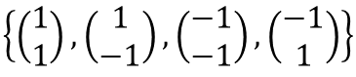
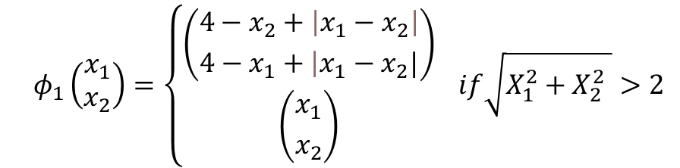
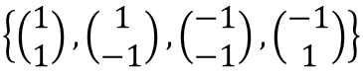
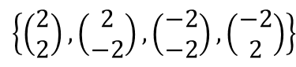
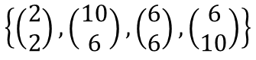
Numerical Example
We need to identify a hyper-plane, or a line that separates data into two groups. However, because this is a non-linear SVM, Kernal SVM must be used to transfer data from one feature space to another.
Kernel SVM condition:
Both positive and negative data points are applied to the condition.
Positive data points:
Negative data points:
$$φ_{1}\left(\begin{matrix}x_{1} \\ x_{2}\end{matrix}\right)=\left\{\begin{aligned}\left({\left.4−x_{2}+\left|x_{1}−x_{2}\right|\right. \atop \left.4−x_{1}+\left|x_{1}−x_{2}|\right.\right.}\right) \\ \left({x_{1} \atop x_{2}}\right)\end{aligned}\right. if\sqrt{X_{1}^{2}+X_{2}^{2} }>2$$
$$\left\{\left(\begin{matrix}2 \\ 2\end{matrix}\right),\left(\begin{matrix}2 \\ −2\end{matrix}\right),\left(\begin{matrix}−2 \\ −2\end{matrix}\right),\left(\begin{matrix}−2 \\ 2\end{matrix}\right)\right\}$$
$$\left\{\left(\begin{matrix}2 \\ 2\end{matrix}\right),\left(\begin{matrix}10 \\ 6\end{matrix}\right),\left(\begin{matrix}6 \\ 6\end{matrix}\right),\left(\begin{matrix}6 \\ 10\end{matrix}\right)\right\}$$
Positive data points
Negative data points
$$\left\{\left(\begin{matrix}1 \\ 1\end{matrix}\right),\left(\begin{matrix}1 \\ −1\end{matrix}\right),\left(\begin{matrix}−1 \\ −1\end{matrix}\right),\left(\begin{matrix}−1 \\ 1\end{matrix}\right)\right\}$$
$$\left\{\left(\begin{matrix}1 \\ 1\end{matrix}\right),\left(\begin{matrix}1 \\ −1\end{matrix}\right),\left(\begin{matrix}−1 \\ −1\end{matrix}\right),\left(\begin{matrix}−1 \\ 1\end{matrix}\right)\right\}$$
22

Slide 23

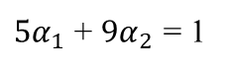
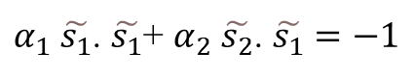
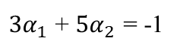
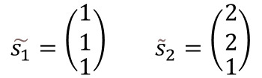
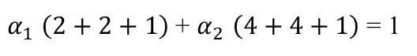
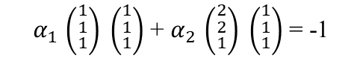
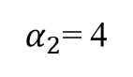
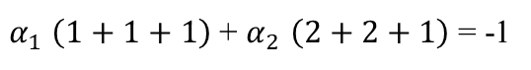

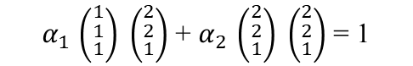
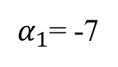
Numerical Example
Based on these data points, if we put it on the plot figure, we can easily find a hyperplane which can divide data points into 2 parts.
Now, we can easily identify the support vectors.
$$\left\{s_{1}=\left(\begin{matrix}1 \\ 1\end{matrix}\right),s_{2}=\left(\begin{matrix}2 \\ 2\end{matrix}\right)\right\}$$
Each vector is augmented with a 1 as a bias input.
$$\tilde{s_{1}}=\left({\begin{aligned}1 \\ 1\end{aligned} \atop 1}\right) {\tilde{s}}_{2}=\left({\begin{aligned}2 \\ 2\end{aligned} \atop 1}\right)$$
$α_{1}$ $\tilde{s_{1}}$. $\tilde{s_{1}}$+ $α_{2}$ $\tilde{s_{2}}$. $\tilde{s_{1}}=−1$
$α_{1}$ $\left(1+1+1\right)$+ $α_{2}$ $\left(2+2+1\right)$= -1
SV
$α_{1}$ $\tilde{s_{1}}$. $\tilde{s_{2}}$+ $α_{2}$ $\tilde{s_{2}}$. $\tilde{s_{2}}=+1$
$α_{1}$ $\left(2+2+1\right)$+ $α_{2}$ $\left(4+4+1\right)$= 1
SV
$α_{1}$ $\left({\begin{aligned}1 \\ 1\end{aligned} \atop 1}\right) \left({\begin{aligned}1 \\ 1\end{aligned} \atop 1}\right)$+ $α_{2}$ $\left({\begin{aligned}2 \\ 2\end{aligned} \atop 1}\right) \left({\begin{aligned}1 \\ 1\end{aligned} \atop 1}\right)$= -1
$3α_{1}$ + ${5α}_{2}$ = -1
$5α_{1}$ + ${9α}_{2}$ = 1
hyperplane
$α_{1}$ $\left({\begin{aligned}1 \\ 1\end{aligned} \atop 1}\right) \left({\begin{aligned}2 \\ 2\end{aligned} \atop 1}\right)$+ $α_{2}$ $\left({\begin{aligned}2 \\ 2\end{aligned} \atop 1}\right) \left({\begin{aligned}2 \\ 2\end{aligned} \atop 1}\right)$= 1
$α_{1}$= -7
$α_{2}$= 4
Source: https://tinyurl.com/eaarrnxr
23

Slide 24
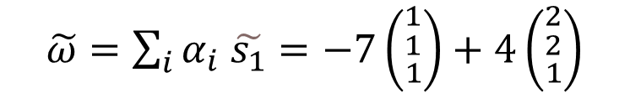
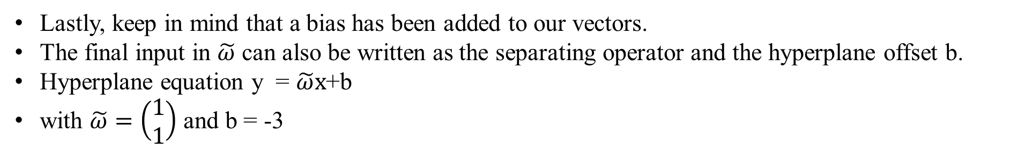
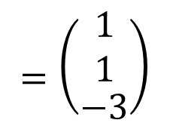
Numerical Example
$\tilde{ω}=\sum_{i}{α_{i}}$ $\tilde{s_{1}}=−7\left({\begin{aligned}1 \\ 1\end{aligned} \atop 1}\right)+4\left({\begin{aligned}2 \\ 2\end{aligned} \atop 1}\right)$
$$=\left({\begin{aligned}1 \\ 1\end{aligned} \atop −3}\right)$$
Lastly, keep in mind that a bias has been added to our vectors.
The final input in $\tilde{ω}$ can also be written as the separating operator and the hyperplane offset b.
Hyperplane equation y = $\tilde{ω}x$+b
with $\tilde{ω}=\left(\begin{aligned}1 \\ 1\end{aligned}\right)$ and b = -3
24

Slide 25
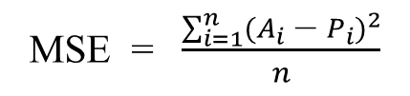
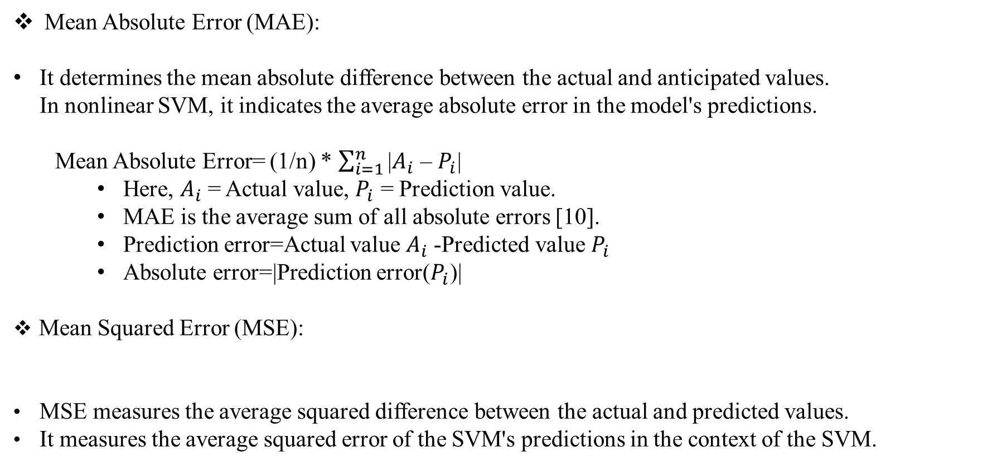
Evaluation Metrics
Mean Absolute Error (MAE):
It determines the mean absolute difference between the actual and anticipated values. In nonlinear SVM, it indicates the average absolute error in the model's predictions.
Mean Absolute Error= (1/n) * $\sum_{i=1}^{n}{\text{|}A_{i}\text{ – }P_{i}\text{|}}$
Here, $A_{i}$= Actual value, $P_{i}$ = Prediction value.
MAE is the average sum of all absolute errors [10].
Prediction error=Actual value $A_{i}$-Predicted value $P_{i}$
Absolute error=|Prediction error($P_{i}$)|
Mean Squared Error (MSE):
MSE measures the average squared difference between the actual and predicted values.
It measures the average squared error of the SVM's predictions in the context of the SVM.
MSE = $\frac{\sum_{i=1}^{n}{{{(A}_{i}\text{ – }P_{i})}^{2}}}{n}$
25

Slide 26
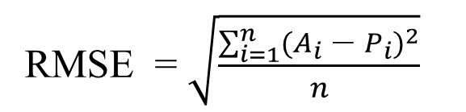
Evaluation Metrics
Root Mean Squared Error (RMSE):
RMSE is the square root of the MSE.
It measures the average squared error of the SVM's predictions in the context of the SVM.
R-squared (R²):
R-squared, commonly known as the coefficient of determination.
The range of the R-squared value is 0 to 1. If the model does not match the algorithm, the result will be negative. If the value is greater than or equal to one, it is the better model.
RMSE = $\sqrt{\frac{\sum_{i=1}^{n}{{{(A}_{i}\text{ – }P_{i})}^{2}}}{n}}$
26

Slide 27

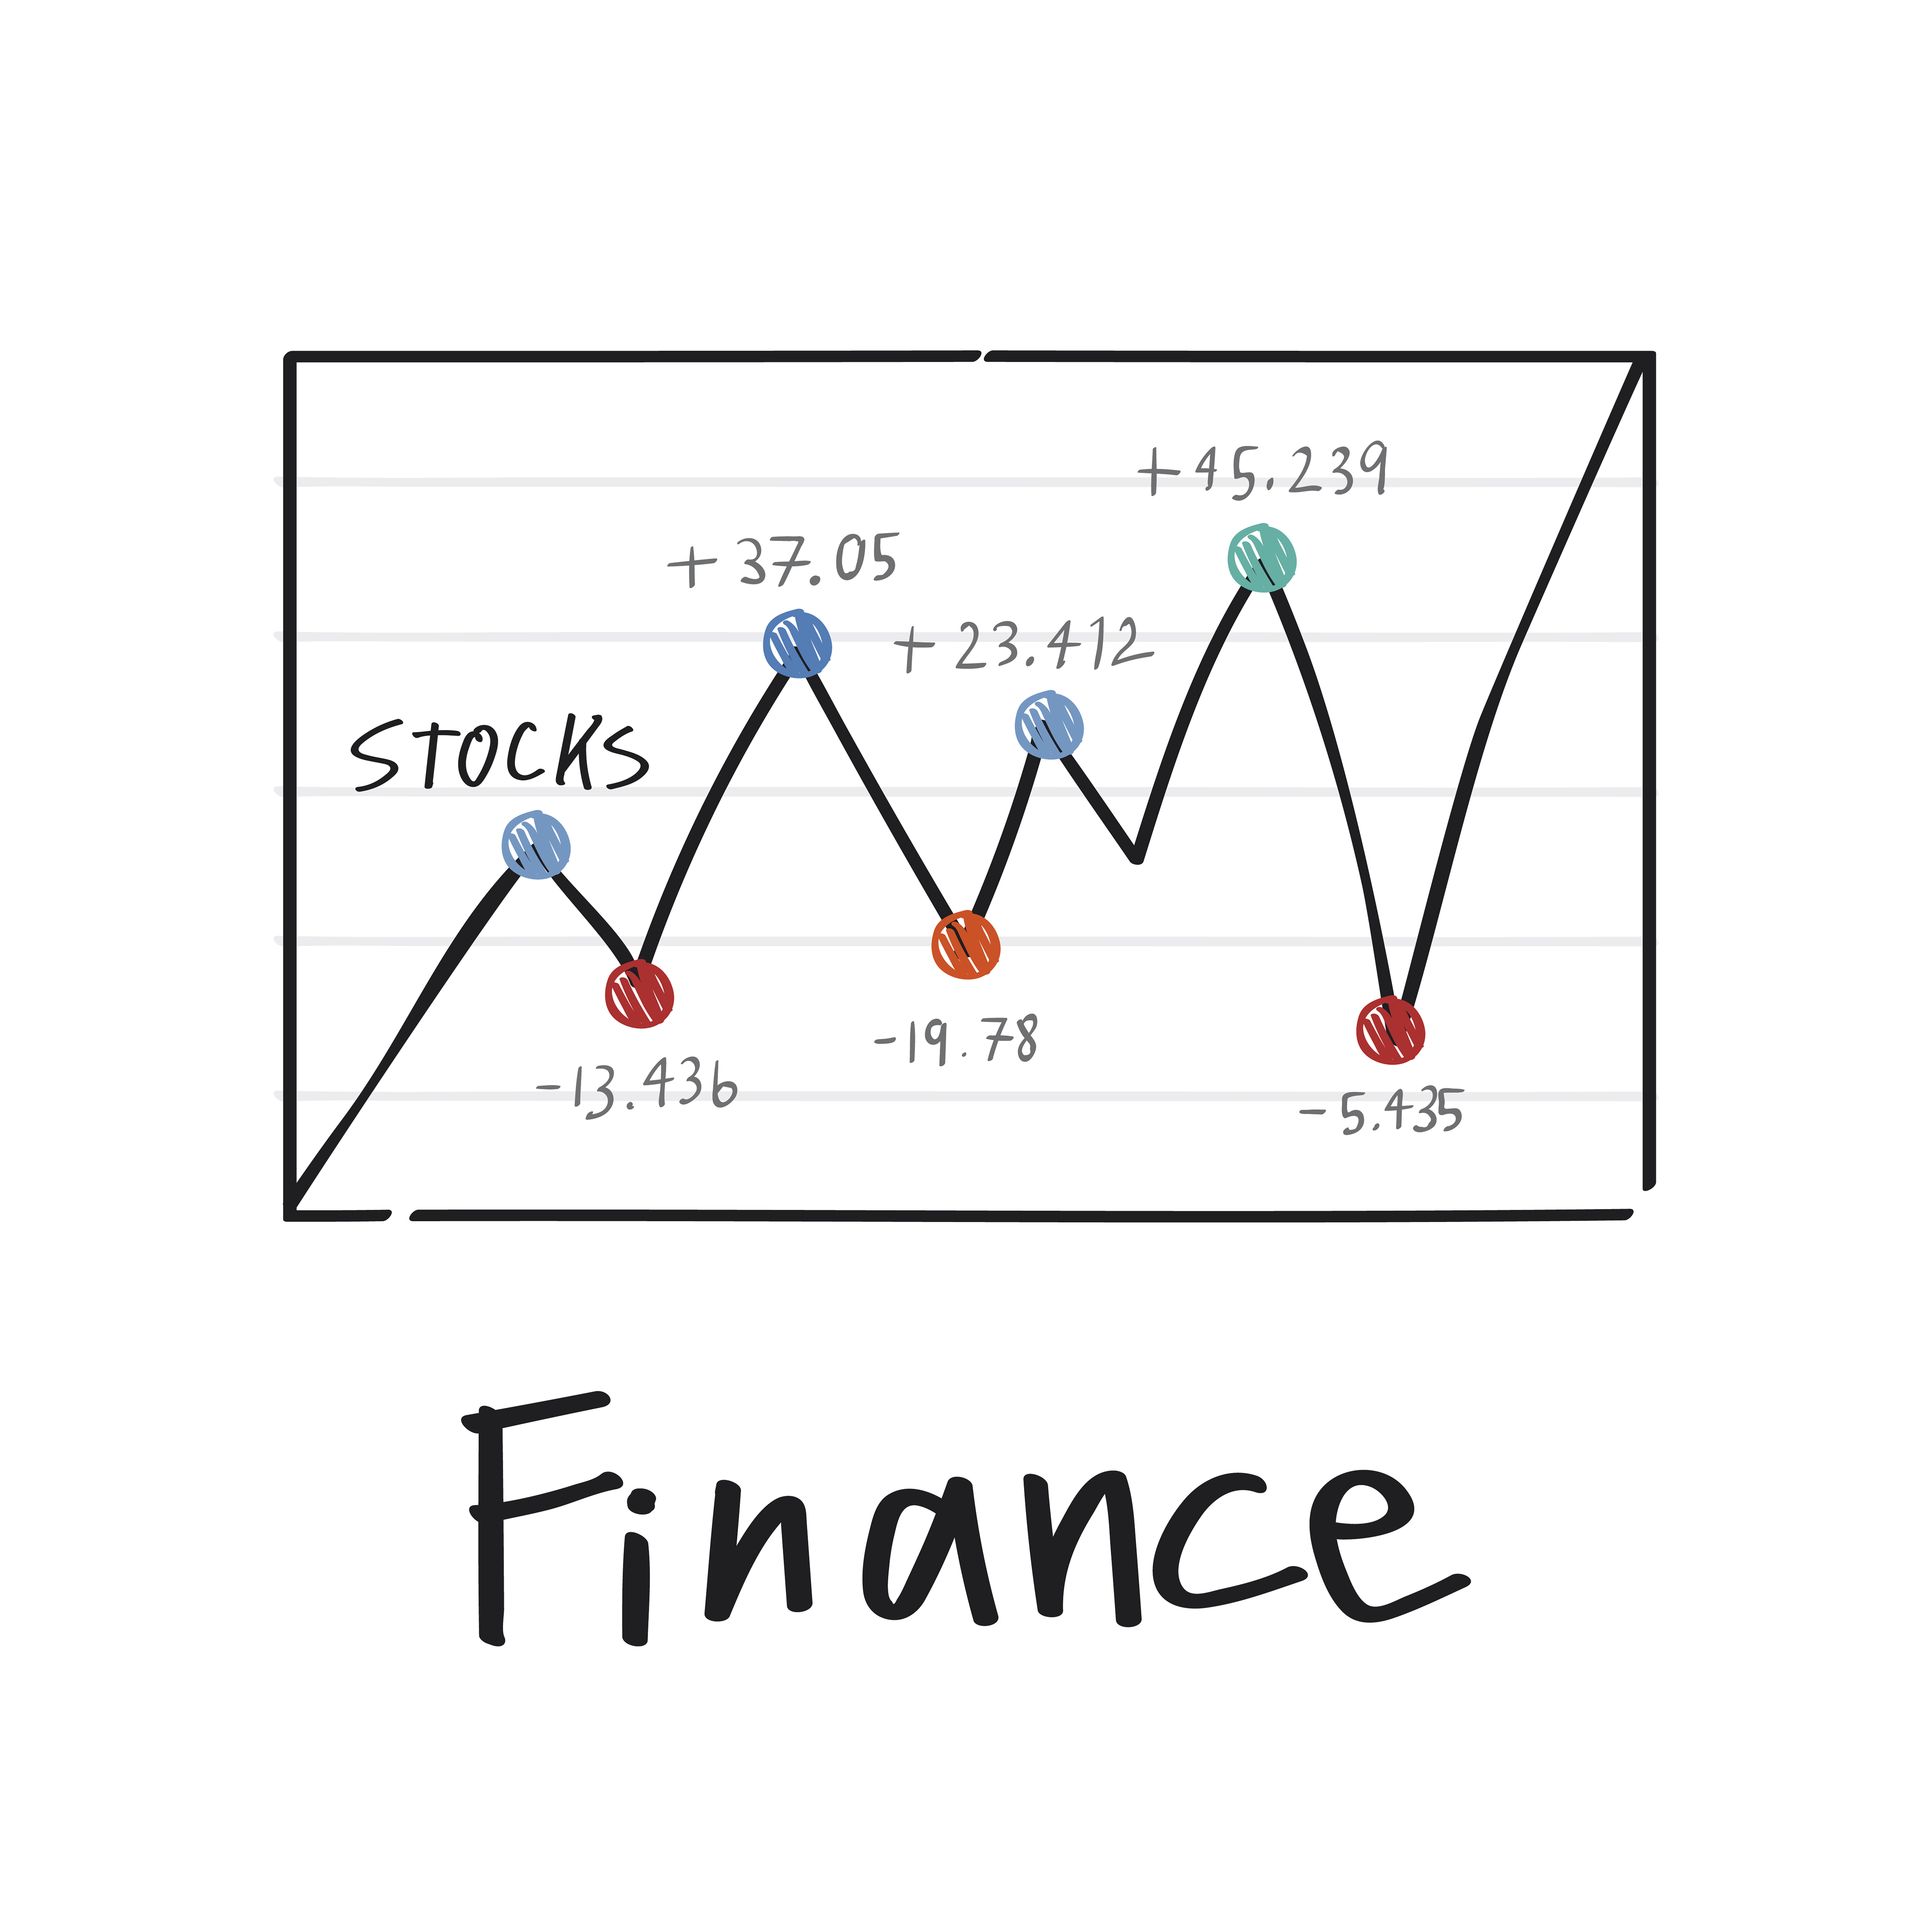


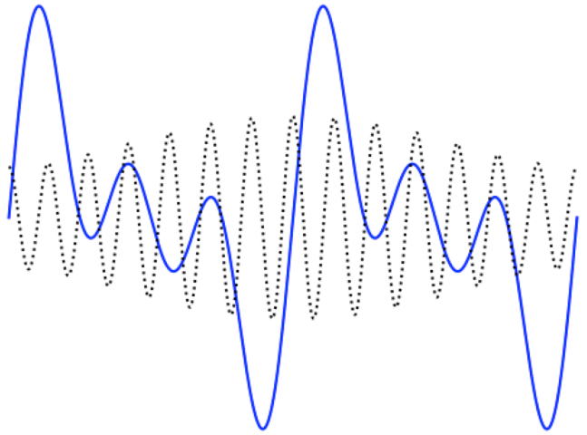
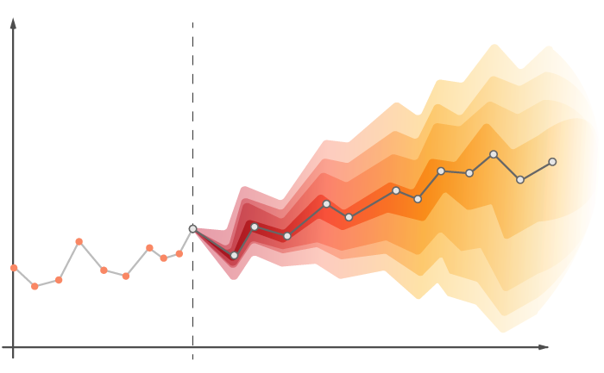
SVM: Applications
Financial Forecasting & Fraud Detection
Natural Language Processing
Image Recognition & Classification
Medical Diagnosis
Signal Processing
Time Series Forecasting
27

Slide 28


Implementation: Intuitive Example
Goal: Determine whether the fruit is Ripe or Not.
Linear Case: Based on Color
Non-Linear Case: Color, firmness, and scent
Linear Classification Plot
Source: https://tinyurl.com/bdfr2hte
28

Slide 29


Implementation: Intuitive Example
Goal: Determine whether the fruit is Ripe or Not.
Non-Linear SVM decides boundary that considers:
Interactions & combinations of features
Identifying complex patterns
Adapting to variations in ripeness.
Non-Linear Classification Plot
Inherently a non-linear problem!
Source: https://tinyurl.com/yvhy5eyz
29

Slide 30
Implementation: Code
# <== Importing Necessary Libraries ==>
import numpy as np
import matplotlib.pyplot as plt
from sklearn.datasets import load_iris
from sklearn.svm import SVC
from sklearn.model_selection import train_test_split
from sklearn.metrics import confusion_matrix, classification_report, accuracy_score
import seaborn as sns
# <== Load the IRIS Dataset ==>
iris = load_iris(as_frame=True)
df = iris.frame
X = df[['sepal length (cm)','petal width (cm)']].values
y = df.target
# <== Split the dataset into training and testing sets ==>
X_train, X_test, y_train, y_test = train_test_split(X, y, test_size=0.2, random_state=2)
# <== Create a non-linear kernel SVM classifier ==>
svm = SVC(kernel='poly', degree=5, random_state=42)
svm.fit(X_train, y_train)
# <== Make predictions on the test data ==>
y_pred = svm.predict(X_test)
# <== Calculate confusion matrix ==>
confusion = confusion_matrix(y_test, y_pred)
30

Slide 31

Implementation: Code
The resulting confusion matrix is as:
Class-wise model evaluation metrics:
Classes | Precision | Recall | F1-Support
setosa | 1.00 | 1.00 | 1.00
versicolor | 0.88 | 0.88 | 0.88
virginica | 0.88 | 0.88 | 0.88
31

Slide 32
Implementation: Decision Boundary
# <== Plotting the decision boundary ==>
x_min, x_max = X[:, 0].min() - 1, X[:, 0].max() + 1
y_min, y_max = X[:, 1].min() - 1, X[:, 1].max() + 1
xx, yy = np.meshgrid(np.arange(x_min, x_max, 0.02),
np.arange(y_min, y_max, 0.02))
Z = svm.predict(np.c_[xx.ravel(), yy.ravel()])
Z = Z.reshape(xx.shape)
plt.figure(figsize=(8, 6))
plt.contourf(xx, yy, Z, alpha=0.5, cmap='plasma')
scatter = plt.scatter(X[:, 0], X[:, 1], c=y, edgecolors='k', cmap='plasma')
plt.xlabel('Sepal Length (cm)')
plt.ylabel('Petal Width (cm)')
plt.title('Data Points Classification using Non-linear Kernel SVM (Poly)')
legend = plt.legend(*scatter.legend_elements(), title="Classes")
# <== Calculating the accuracy ==>
y_pred = svm.predict(X_test)
accuracy = (y_pred == y_test).mean()
plt.text(5.5, 0, f'Accuracy: {accuracy * 100:.2f}%', fontsize=12, bbox=dict(facecolor='white', alpha=0.7))
plt.show()
32

Slide 33

Implementation: Decision Boundary
The resulting decision boundary with accuracy is as:
33

Slide 34
Implementation: Code
Code Link: http://tiny.cc/non-linear-svm-example
34

Slide 35
Non-Linear SVM: Comparision
Advantages
Limitations
Handling Non-Linearity
High Accuracy
Robust to Outliers
Effective in High Dimensional
Wide Range of Applications
Computationally Intensive
Parameter Sensitivity
Limited Scalability
Prone to Overfitting
Choosing Kernel Functions
35

Slide 36

Overcoming Limitations
Computationally Intensive: Dimensionality Reduction, Efficient Libraries
Parameter Sensitivity: Grid Search, Regularization
Limited Scalability: Linear Approximations, Parallelization
Prone to Overfitting: Feature Selection, Regularization
Choosing Kernel Functions: Cross-Validation, Kernel Parameters
36

Slide 37
Conclusion
Overview: Linear vs Non-Linear SVMs
Kernel Functions: Types, Underlying Concepts
Mathematical Equations: Algorithm and Hyperparameters
Evaluation Metrics: Assess model behavior
Implementation & Applications
Benefits
Versatile & Powerful: Complex classification problems.
Excels in Non-linear relationships: Suitable for a wide range of applications.
Choice of Kernels & Hyperparameters: Crucial for Optimal Performance
37

Slide 38
Other Important Links
https://www.youtube.com/watch?v=DB6fCUBKiKs
https://www.youtube.com/watch?v=qjErFs0tepw
https://www.youtube.com/watch?v=bwrKtkW2RdI
https://www.youtube.com/watch?v=03IrkMM4E6M
38

Slide 39
References
[1] S. Arora, “SVM: Difference between Linear and Non-Linear Models,” AITUDE, Feb. 04, 2020. https://www.aitude.com/svm-difference-between-linear-and-non-linear-models/
[2] M. Ahmed, “Non-linear Support Vector Machines Explained,” Medium, May 21, 2022. https://linguisticmaz.medium.com/support-vector-machines-explained-ii-f2688fbf02ae
[3] B. Gupta, “Non-Linear SVM,” Scaler Topics, Feb. 02, 2023. https://www.scaler.com/topics/machine-learning/non-linear-svm/
[4] “Nonlinear Support Vector Machine - an overview | ScienceDirect Topics,” www.sciencedirect.com. https://www.sciencedirect.com/topics/engineering/nonlinear-support-vector-machine
[5] V. Piccialli and M. Sciandrone, “Nonlinear optimization and support vector machines,” Annals of Operations Research, vol. 314, no. 1, pp. 15–47, Apr. 2022, doi: https://doi.org/10.1007/s10479-022-04655-x.
[6] “Linear SVM vs Nonlinear SVM high dimensional data,” Stack Overflow. https://stackoverflow.com/questions/44606126/linear-svm-vs-nonlinear-svm-high-dimensional-data‌
39

Slide 40
Thank You!
40

